Slide 1
PRODUCT, PROCESS, AND SCHEDULE DESIGN
Facilities planning process for manufacturing can be listed as.
1. Define the products to be manufactured.
2. Specify the manufacturing processes and related activities required to produce the products.
3. Determine the interrelationships among all activities.
4. Determine the space requirements for all activities.
5. Generate alternative facilities plans.
6. Evaluate the alternative facilities plans.
7. Select the preferred facilities plan.
8. Implement the facilities plan.
9. Maintain and adapt the facilities plan.
10. Update the products to be manufactured and redefine the objective of the facility.

Slide 2
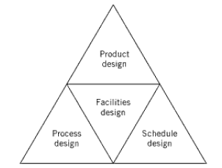
Relationship between product, process, and schedule

Slide 3
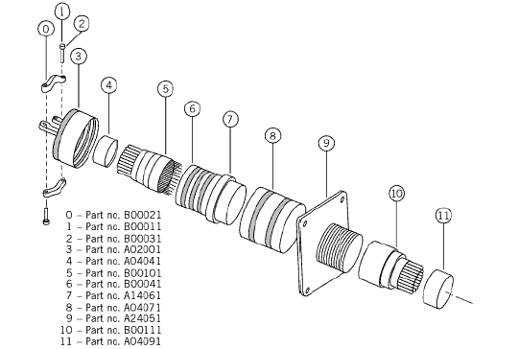
4.1. Product Design
Product design involves both the determination of which products are to be produced and the detailed design of individual products.
Decisions made by top management based on input from
Marketing,
Manufacturing, and
Finance concerning projected economic performance.

Slide 4
4.2 Process Design
The process designer or process planner is responsible for determining how the products to be produced.
The “make-or-buy” decision is part of the process planning function

Slide 5
